Slide 1
Big Data Predictive Analysis: Using R Analytical Tool
Authors :
By Priyanka Shinde, Kavita Oza, R K Kamat
-Srinil Khandwala
A2
1911023

Slide 2
Introduction
In this paper, big data has been analyzed using one of the advance and effective data processing tool known as R Studio to depict predictive model based on results of big data analysis.
Algorithms used are - Random Forest (RF) and Latent Dirichlet Allocation (LDA).
Author performed these algorithms on healthcare associated big data to provide better diagnosis.

Slide 3
What is Big Data?
Data is collection of facts, stats and information together which can help one to understand particular area in depth.
It has characteristics like Volume, Variety, and Accuracy and often available in unstructured format.
There are many different fields like social media, education, agriculture, healthcare, science etc. which are generating big data.

Slide 4
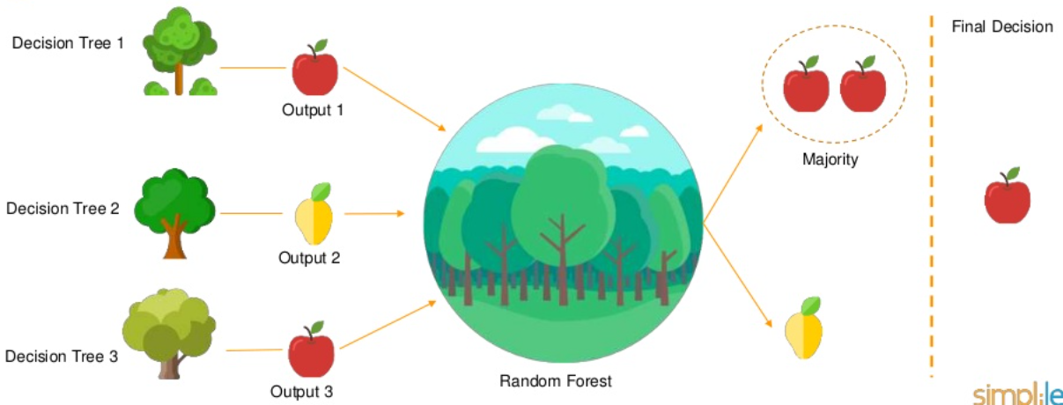
Random forest Algorithm
A method that operates by constructing multiple decision trees during training phase. The decision of the majority of the trees is chosen by the random forest as the final decision.

Slide 5
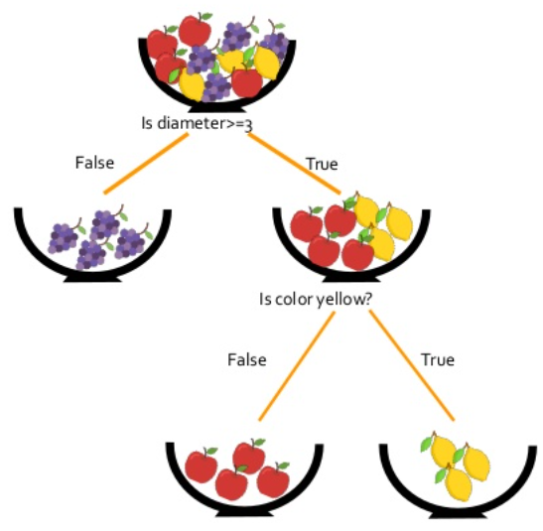
Decision Tree
A tree shaped diagram used to determine a course of action .Each branch represents a possible decision, occurrence or reaction.
Entropy decreases after every split which, increases the information gain.
The top most decision node is known as the root node.
Decision node has 2 or more branches.
Leaf node carries the decision or classification.

Slide 6
Working of Random Forest
Step 1 − First, start with the selection of random samples from a given dataset.
Step 2 −The algorithm will construct a decision tree for every sample .Then it will get the prediction result from every decision tree.
Step 3 − Voting will be performed for every predicted result.
Step 4 − At last, select the most voted prediction result as the final prediction result.

Slide 7
Advantages:
No overfitting
High Accuracy- Runs efficiently on large databases
Training time is less
Estimates missing Data : when a large proportion of data is missing

Slide 8
Latent Dirichlet Allocation(LDA)
It is one of the most popular topic modeling methods.
Topic Modeling – It provides methods for automatically organizing, understanding, searching, and summarizing large electronic archives.
For example, let’s say a document belongs to the topics food, dogs and health. So if a user queries “dog food”, the above mentioned document would be relevant.
The aim of LDA is to find topics a document belongs to, based on the words in it.

Slide 9
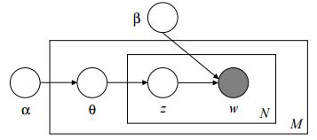
Plate notation
It’s a concise way of visually representing the dependencies among the model parameters
M = total no of documents within the corpus
N= no of words in a document
 and β are Dirichlet distributions
θ is the topic distribution per document M
Z is the topic assigned to n-th word in the document M
w is the specific word

Slide 10
LDA assumes that documents are composed of words that help determine the topics and maps documents to a list of topics by assigning each word in the document to different topics.
The assignment is in terms of conditional probability estimates.
LDA ignores the order of occurrence of words and the syntactic information. It treats documents just as a collection of words or a bag of words.

Slide 11
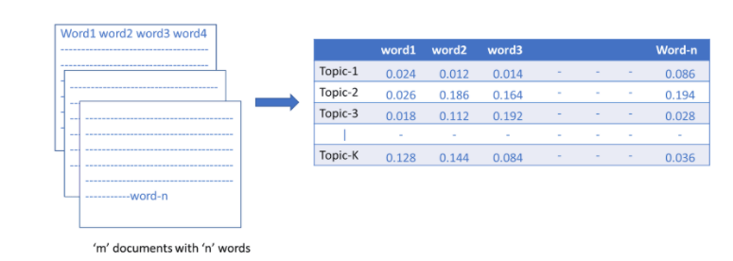
In the above table each row represents a different topic and each column, a different word in the corpus. Each cell contains the probability that the word(column) belongs to the particular topic(row).
Finding Representative Words for a Topic:
We can sort the words with respect to their probability score. If x = 10, we’ll sort all the words in topic1 based on their score and take the top 10 words to represent the topic.
We can also set a threshold.

Slide 12
Generative Process
LDA assumes that new documents are created in the following way:
Determine number of words in document.
Choose a topic mixture for the document over a fixed set of topics (i.e. 20% topic A, 30% topic B, 50% topic C).
Generate the words in the document by:
First pick a topic based on the document’s multinomial distribution(i.e. 20%, 30%, 50%).
Next pick a word based on the topic’s multinomial distribution.

Slide 13
Generative Process example:
Say we have a group of articles and we assume that all of those articles can be characterized by 3 topics Animals, Cooking ,City.
Each topic can be described by the following words :
Animals: dog, chicken, cat, nature ,zoo
Cooking : oven , food, restaurant, plate ,taste
City : Building ,Road ,Flyover ,crowded
Say we want to generate a document that is 80% about “Animals” and 20% about “cooking”.
We choose length of the article(say 1000 words).
We choose topic based on our specified mixture (so , out of 1000 words , roughly 800 will come from the topic “animals”).
We choose a word based on the word distribution for each topic.

Slide 14
Working backwards
Suppose you have a corpus of documents.
You want LDA to learn the topic representation of K topics in each document and word distribution of each topic.
LDA backtracks from the document level to identify topics that are likely to have generated the corpus.

Slide 15


Working of LDA (backwards)
Randomly assign each word in each document to one of the K topics.
For each document d:
Assume that all topic assignments except for the current one are correct .
Calculate two proportion:
Proportion of words in document d that are currently assigned to topic t = p(topic t | document)
Proportion of assignments to topic t over all documents that come from this word w = p(word w | topic t)
Multiply those 2 proportions and assign w a new topic based on that probability = p(topic t | document)* p(word w | topic t)
Eventually we’ll reach a steady state where assignments make sense.

Slide 16
LDA takes a number of documents and assumes that the words in each document are related .
We just need to tell the model how many topics to construct .
Based on the output , we can identify similar documents within the corpus.
Advantages
Effective tool for topic modeling.
Easy to understand conceptually.
Limitations:
Must know the number of topics in advance.

Slide 17
Results
The authors used health related data having information related to fertility.
They used both algorithms to prove their effectiveness .
Random Forest | LDA
Accuracy: 0.9871 | Accuracy: 0.8501
Detection rate: 0.8915 | Detection Rate: 0.8501
Sensitivity : 0.9914 | Sensitivity : 0.9454
Specificity : 0.9487 | Specificity : 0.0000

Slide 18
Conclusion
There are many different tools and techniques available using which big data can be analyzed wisely.
Both methods, Random Forest and LDA provided great results.
Comparing results of case study by the author suggests that Random Forest Algorithm has bit better accuracy than Latent Dirichlet allocation.

Slide 19
References
Random Forest :
https://www.tutorialspoint.com/machine_learning_with_python/machine_learning_with_python_classification_algorithms_random_forest.htm
LDA :
https://www.mygreatlearning.com/blog/understanding-latent-dirichlet-allocation/
https://towardsdatascience.com/latent-dirichlet-allocation-lda-9d1cd064ffa2
https://degreesofbelief.roryquinn.com/common-evaluation-measures-for-classification-models

Slide 20
Thank You!!

